Slide 1
CSF 2113 Programming for Information Security
Web crawling with Scrapy (CLO4)
Muhammad Humayoun, PhD
Assistant Professor
mhumayoun@hct.ac.ae
Abu Dhabi Men’s College

Slide 2
Table of Contents
Crawler in Scrapy
Scraping interesting information about web application

Slide 3
Creating a Web Crawler with Scrapy
Decide what to scrap
First Scrapy project
Creating the spider for Scrapy
Running the crawler

Slide 4
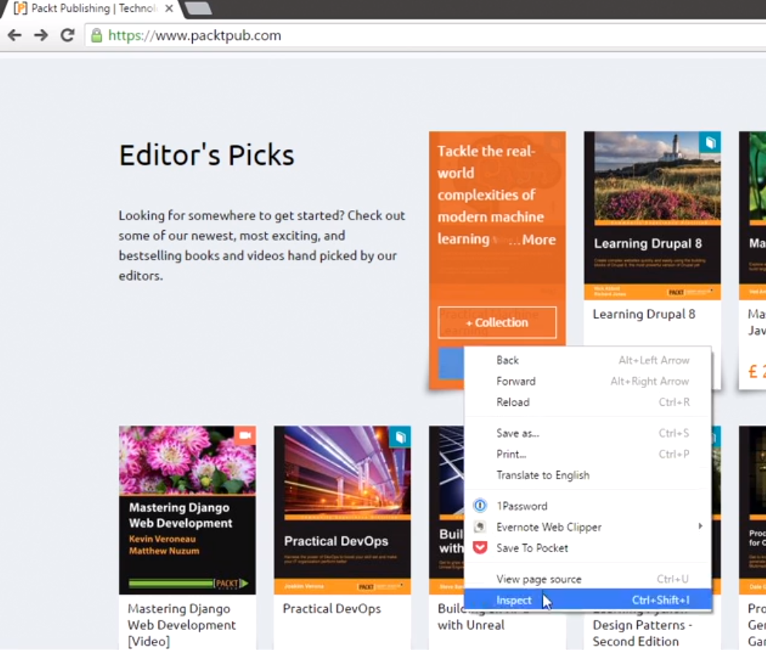
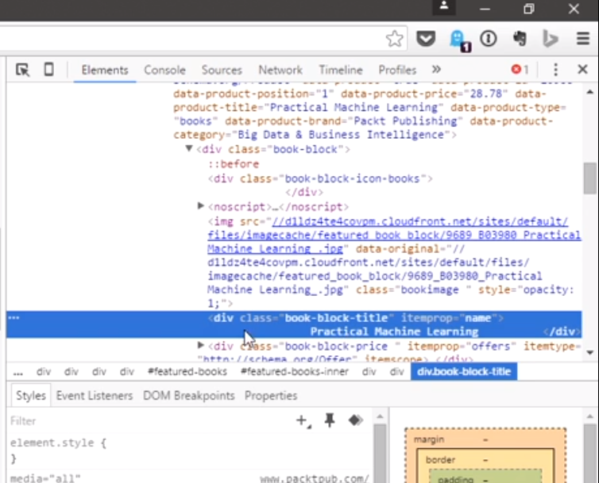
Decide what to scrap
We need to define the objective (Extract all book titles form www.packtpub.com)
Analyze the target: right click on a book title -> inspect

Slide 5
Scraping book titles
We can see div with a class of book-block-title and then the title name.
We need this to define what we want to extract in our crawl process
<div class=“book-block-title” itemprop=“name”>
Practical Machine Learning </div>

Slide 6
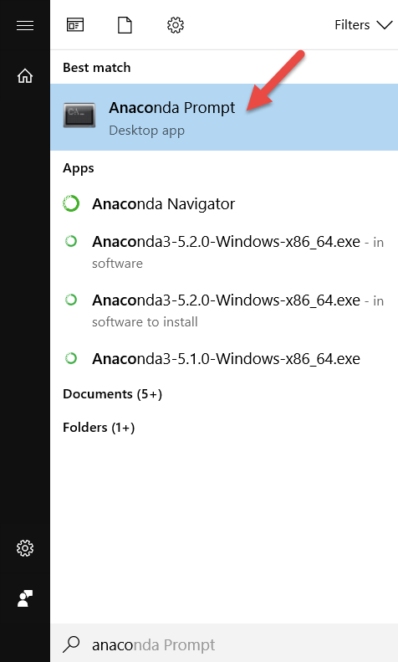
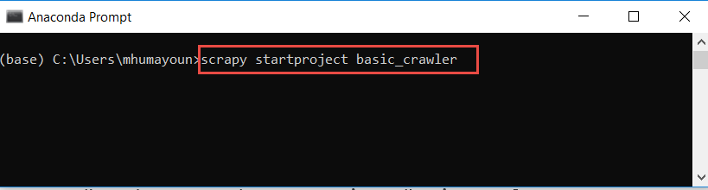
Creating first Scrapy project
Start a new Scrapy project:
$ scrapy startproject basic_crawler
New Scrapy project ‘basic_crawler’ created in:
/home/pentester/scrapy_projects/basic_crawler
You can start your first spider with:
cd basic_crawler
scrapy genspider example example.com
Execute the command in ‘Anaconda prompt’
(for windows 10,
in bash for Linux)

Slide 7
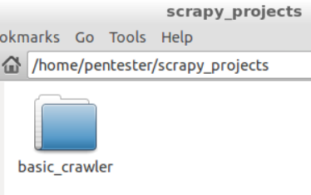
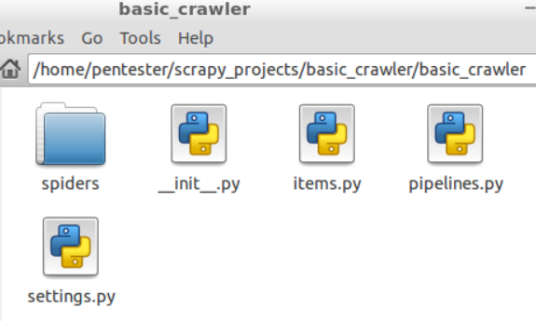
Creating first Scrapy project
Inside the basic_crawler directory, you will see another folder called basic_crawler
Start a new Scrapy project:
$ scrapy startproject basic_crawler
New Scrapy project ‘basic_crawler’ created in:
/home/pentester/scrapy_projects/basic_crawler
You can start your first spider with:
cd basic_crawler
scrapy genspider example example.com
When we create a project, Scrapy automatically generates a folder with the basic structure of the crawler
We shall work with the content of the spiders folder

Slide 8
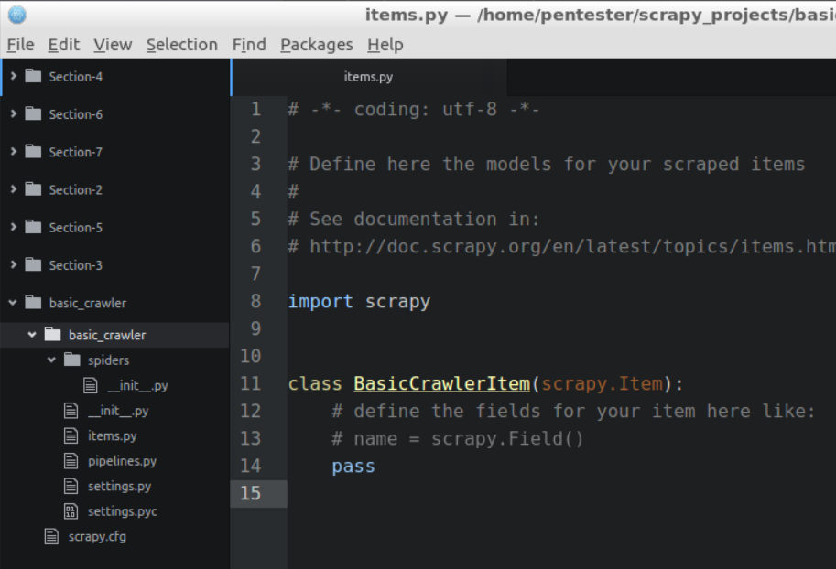
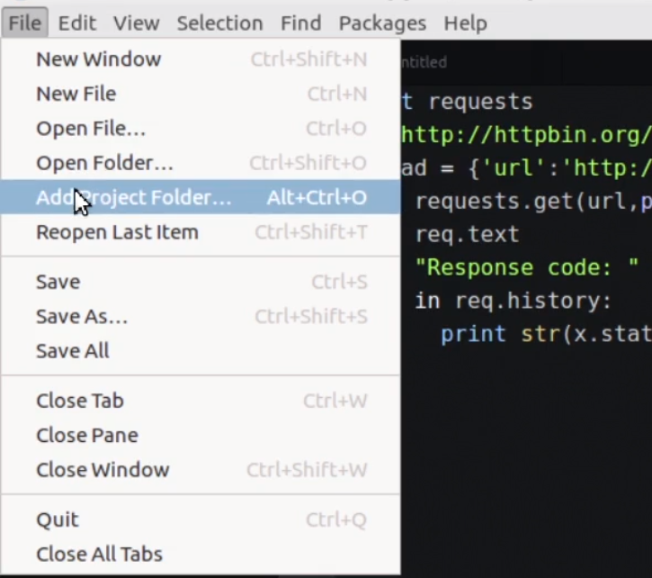
First Scrapy project
The basic structure of a Scrapy project
Open the Atom editor, add this project with ”add a project folder”, and select basic_crawler

Slide 9
Directory structure of the project
basic_crawler/
scrapy.cfg # deploy configuration file
basic_crawler/ # project's Python module, you'll import your code from here
__init__.py
items.py # project items definition file
middlewares.py # project middlewares file
pipelines.py # project pipelines file
settings.py # project settings file
spiders/ # a directory where you'll later put your spiders
# we’ll create a spider in this folder
__init__.py

Slide 10
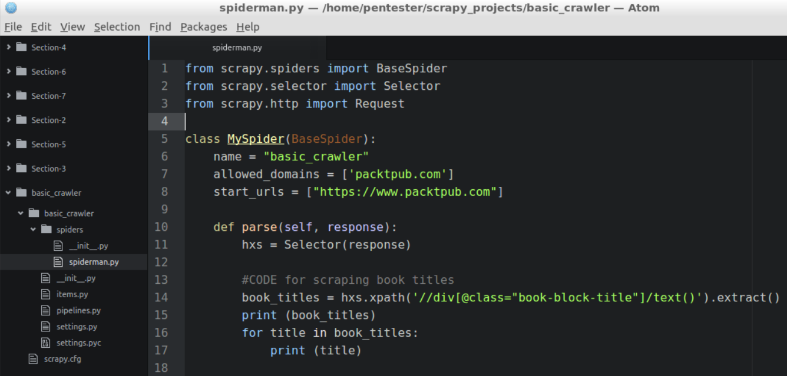
Create new Python file spiderman.py in ‘basic_crawler/spiders’ directory
BaseSpider: Basic crawling class
Selector: Extracts data using Xpath
Request: Performs the http request to the website
Our class inherits the functionality from BaseSpider
Crawler name
a list of domains, which are allowed to be crawled
Filter the lines containing:
<div class=“book-block-title”
and extract its text

Slide 11
Scraping book titles
We can see div with a class of book-block-title and then the title name.
We need this to define what we want to extract in our crawl process
<div class=“book-block-title” itemprop=“name”>
Practical Machine Learning </div>
Corresponds to the xpath:
//div[@class="book-block-title"]/text()

Slide 12


Create new Python file spiderman.py in ‘basic_crawler/spiders’ directory
name: identifies the Spider. It must be unique within a project, that is, you can’t set the same name for different Spiders.
parse(): a method that will be called to handle the response downloaded for each of the requests made.
The response parameter is an instance of TextResponse that holds the page content and has further helpful methods to handle it.

Slide 13
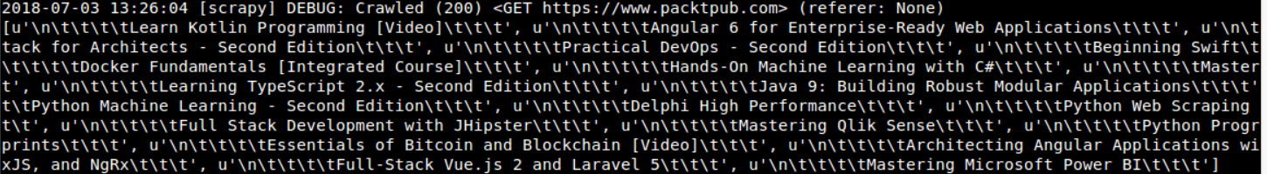
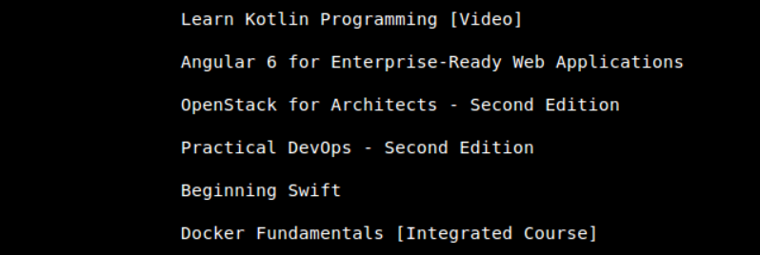
Executing the code
~/scrapy_projects/basic_crawler$ scrapy crawl basic_crawler
basic_crawler because it is the name of our spider i.e.spiderman.py
And so on

Slide 14
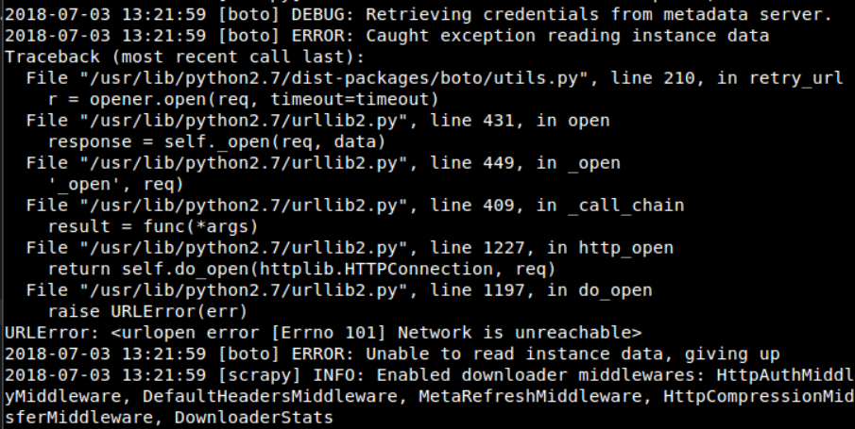
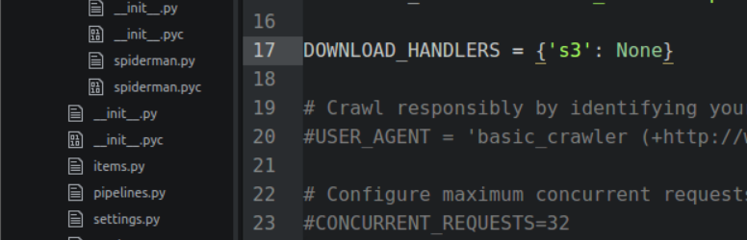
Attention: If you see the following error message:
It is a scrapy bug, either
upgrade to scrapy 1.x or add:
DOWNLOAD_HANDLERS = {'s3': None}
to settings.py

Slide 15
The First Proper Scrapy project
Start a new Scrapy project:
$ scrapy startproject basic_crawler_proper
New Scrapy project 'basic_crawler_proper' created in:
/home/pentester/scrapy_projects/basic_crawler_proper
You can start your first spider with:
cd basic_crawler_proper
scrapy genspider example example.com
Execute in ‘Anaconda prompt’
(for windows 10, in bash for Linux)

Slide 16
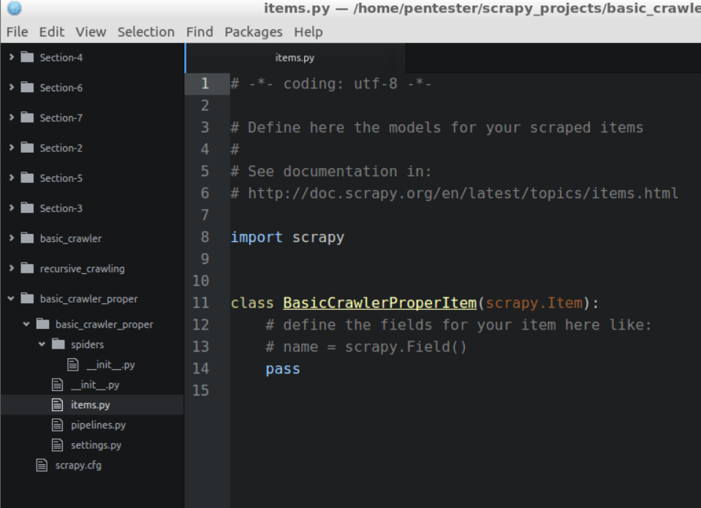
The First Proper Scrapy project
We need to specify what are the things we are interested in getting while crawling a website
These things are called items in Scrapy and think about them as our data model
Edit the items.py file and define our first item
We can see the class BasicCrawlerItem was created
Open the Atom editor, add this project with ”add a project folder”, and select basic_crawler_proper

Slide 17
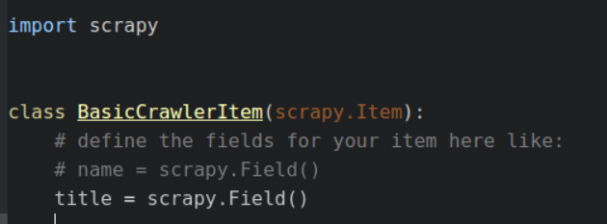
Add this line and delete pass which was already written
Step1: Working on the class BasicCrawlerItem in items.py

Slide 18
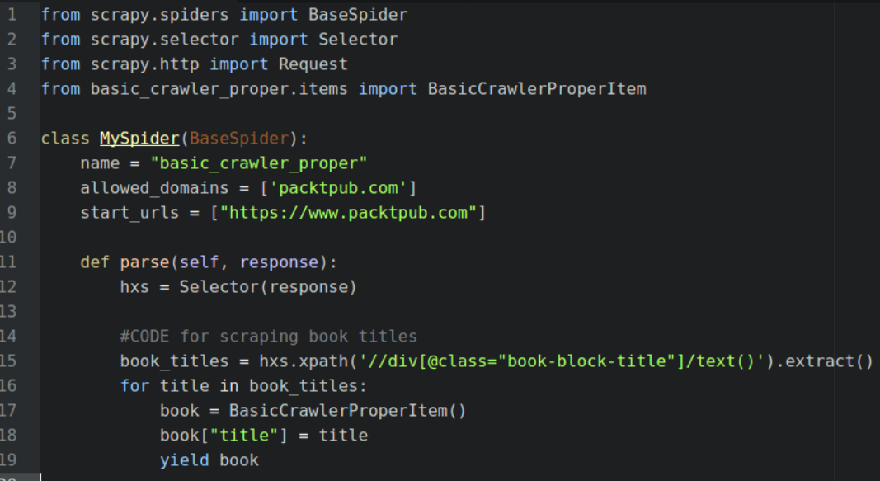
Step2: Create new py file spiderman.py in ‘basic_crawler/spiders’ directory as before

Slide 19
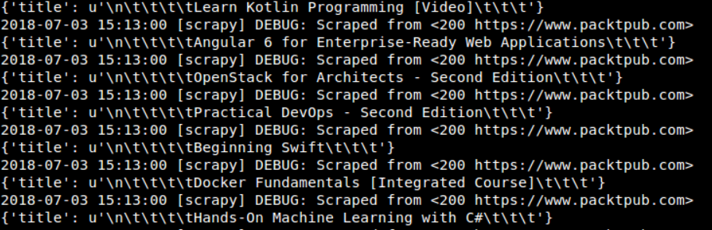
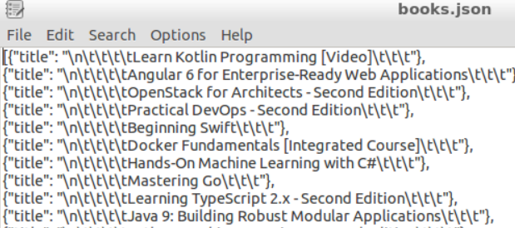
Executing the code
~/scrapy_projects/basic_crawler_proper$ scrapy crawl basic_crawler_proper
Writing in a file in json format (must be run from ~/scrapy_projects/basic_crawler_proper$):
$ scrapy crawl basic_crawler_proper -o books.json –t json
Writing in a file in csv format:
$ scrapy crawl basic_crawler_proper -o books.csv –t csv

Slide 20
JSON: JavaScript Object Notation
JSON is a syntax for storing and exchanging data.
JSON is text, written with JavaScript object notation.
When exchanging data between a browser and a server, the data can only be text.
JSON is text, and we can convert any JavaScript object into JSON, and send JSON to the server.
We can also convert any JSON received from the server into JavaScript objects.
This way we can work with the data as JavaScript objects, with no complicated parsing and translations.

Slide 21
JSON examples:
'{"name":"John", "age":31, "city":"New York"}';
[{“Title”:“\n\tLearn Kotlin programming…”},
{{“Title”:“\n\tAngular 6 for Enterprise-Ready Web…”},
…
]

Slide 22
CSV: Comma Separated Values
CSV is a simple file format used to store tabular data, such as a spreadsheet or database.
Files in the CSV format can be imported to and exported from programs that store data in tables, such as Microsoft Excel or OpenOffice Calc.

Slide 23
Name | Class | Dorm | Room | GPA
Sally Whittaker | 2018 | McCarren House | 312 | 3.75
Belinda Jameson | 2017 | Cushing House | 148 | 3.52
Jeff Smith | 2018 | Prescott House | 17-D | 3.20
Sandy Allen | 2019 | Oliver House | 108 | 3.48
Sally Whittaker,2018,McCarren House,312,3.75
Belinda Jameson,2017,Cushing House,148,3.52
Jeff Smith,2018,Prescott House,17-D,3.20
Sandy Allen,2019,Oliver House,108,3.48

Slide 24
Know more about xpaths
http://pythonscraping.com/blog/xpath-and-scrapy
https://blog.michaelyin.info/scrapy-tutorial-7-how-use-xpath-scrapy/

